Slide 1
Bagging - Aggregate Bootstrapping
For i = 1 .. M
Draw n*<n samples from D with replacement
Learn classifier C_{i}
Final classifier is a vote of C₁ .. C_{M}
Increases classifier stability/reduces variance
D2
D1
D3
D
Notes:
The previous section addressed the use of resampling in estimating statistics
Now we turn to a number of general resampling methods for training classifiers.
Bagging uses multiple versions of a training set, each created by drawing n* samples from D with replacement. Each of these bootstrap data sets is used to train a different “component classifier” and the final classification decision is based on the vote of each component classifier.

Slide 2
Boosting (Schapire 1989)
Consider creating three component classifiers for a two-category problem through boosting.
Randomly select n₁ < n samples from D without replacement to obtain D₁
Train weak learner C₁
Select n₂ < n samples from D with half of the samples misclassified by C₁ to obtain D₂
Train weak learner C₂
Select all remaining samples from D that C₁ and C₂ disagree on
Train weak learner C₃
Final classifier is vote of weak learners
D
D3
D1
D2
-
+
+
-
Notes:
The goal of boosting is to improve the accuracy of any given learning algorithm.
Consider creating three component classifiers for a two-category problem through boosting.
First, ……, call this set D1. Based on D1, train the first classifier, C1.
Now, we seek a second training set D2, half of the patterns in D2 should be correctly classified by C1, half incorrectly classified by C1.
Next, we seek a third data set D3,

Slide 3

Adaboost - Adaptive Boosting
Instead of resampling, uses training set re-weighting
Each training sample uses a weight to determine the probability of being selected for a training set.
AdaBoost is an algorithm for constructing a “strong” classifier as linear combination of “simple” “weak” classifier
Final classification based on weighted vote of weak classifiers
AdaBoost is a popular boosting technique which helps you combine multiple “weak classifiers” into a single “strong classifier”. A weak classifier is simply a classifier that performs poorly, but performs better than random guessing.

Slide 4
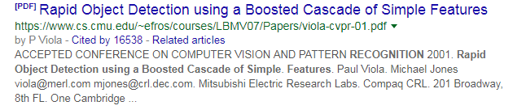
Benchmark for Face detection algorithms (Viola Jones) uses Adaboost

Slide 5
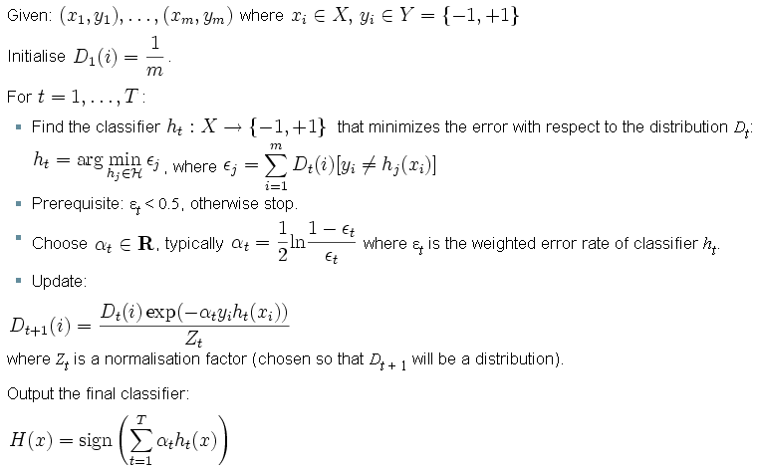
Discrete Adaboost Algorithm
Each training sample has a weight, which determines the probability of being selected for training the component classifier
Notes:
D(i) is weight for each training sample, which determines the probability of being selected for a training set for an individual component classifier.
(Epislon is the sum of the weights of those misclassified samples.)
Specifically, we initialize the weights across the training set to be uniform.
On each iteration t, we find a classifier h(x) that minimizes the error with respect to the distribution.
Next we increase weights of training examples misclassified by h(x), and decrease weights of the examples correctly classified by h(x)
The new distribution is used to train the next classifier, and the process is iterated.

Slide 6
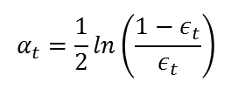
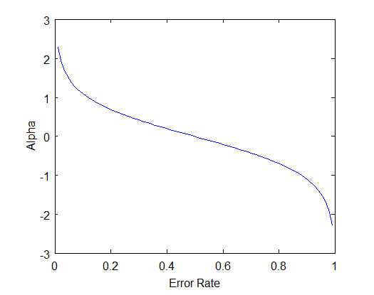


Slide 7
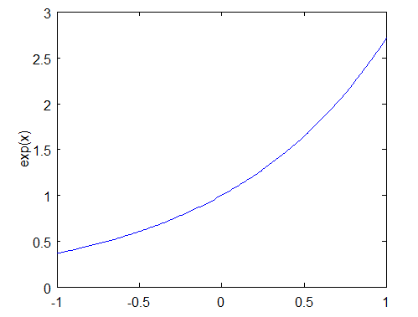
AdaBoost increases the weight on the misclassified examples so that these examples will make up a larger part of the next classifiers training set, and hopefully the next classifier trained will perform better on them.

Slide 8
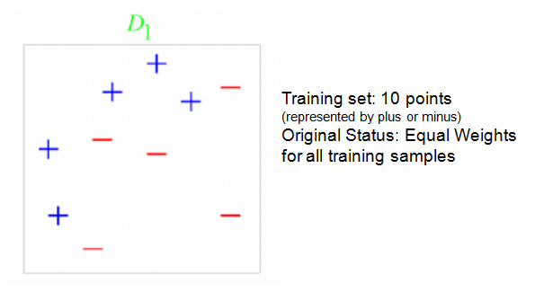
Example

Slide 9
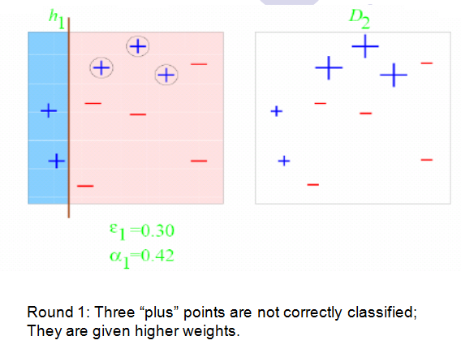

Slide 10
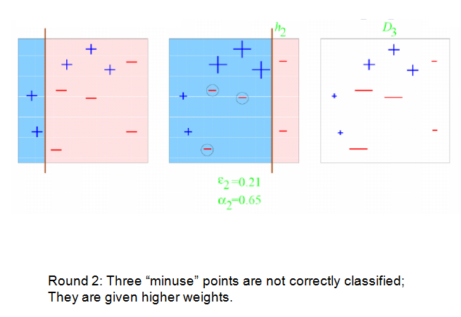

Slide 11
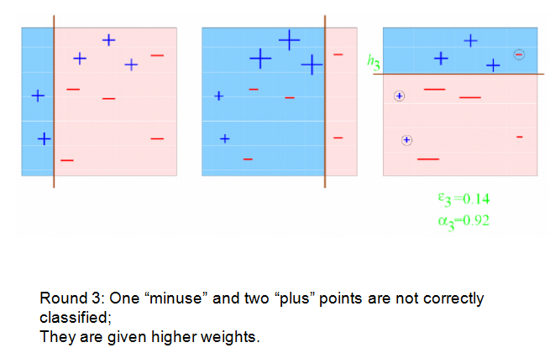

Slide 12
Final Classifier: integrate the three “weak” classifiers and obtain a final strong classifier.

Slide 13
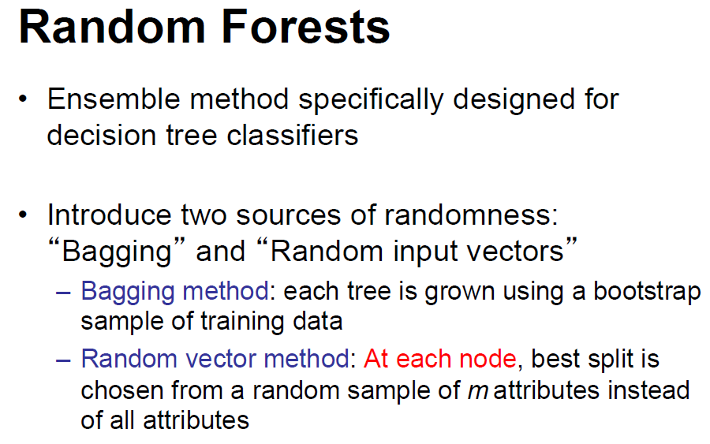

Slide 14
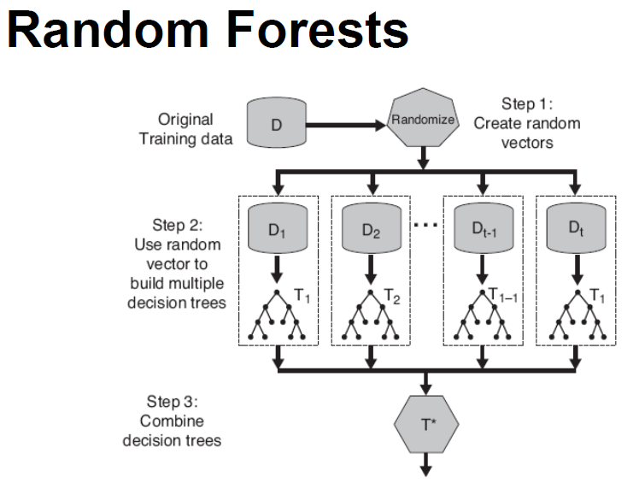
Draw a bootstrap sample of size N
Fix a m <= M. At each node
Choose m attributes randomly, compute their information
gains, and choose the attribute with the largest gain to split

